Slide 1
Inventory Forecasting
Avinash Pandey
Mukund Sudharshan
Shriprasad Marathe

Slide 2
Contents
Data Analysis
Data Pre-processing
Model Selection and Evaluation
Accuracy Matrix
Models Finalized
Parameter Tuning
Forecasted Results

Slide 3
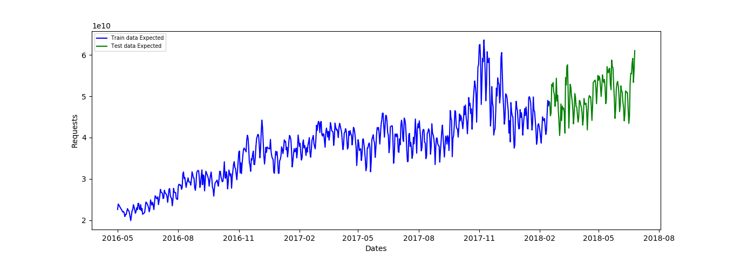
Data Analysis
Training Data: 645 Test Data: 130

Slide 4
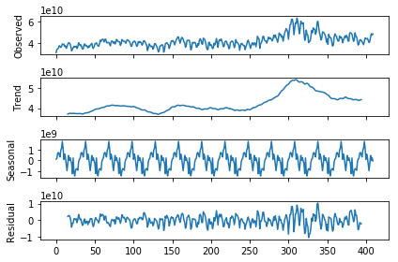
Trend & Seasonality in Data

Slide 5
Data Pre-Processing(Linear Regression)
Extracted the following information from the date field as a input to the Linear Model. Eg: For 1/5/16 and accordingly others. Weekday and quarter are the features extracted from the date itself.
day | month | year | weekday | quarter
1 | 5 | 2016 | 6 | 2
2 | 5 | 2016 | 0 | 2
9 | 5 | 2016 | 0 | 2
10 | 5 | 2016 | 1 | 2

Slide 6
ML Model Selection
Conventional Forecasting Methods
Naive Method
Simple Average
Moving Average (MA)
Weighted Moving Average
Simple Exponential Smoothing
Holt Linear Method
Holt Winters Method
Autoregression (AR)
ARIMA (AutoRegressive Integrated Moving Average)
SARIMA (Seasonal ARIMA)

Slide 7
ML Model Selection
Unconventional Methods
Linear Regression (LR)
Facebook’s Prophet
Neural Networks (MLP)

Slide 8
Model Evaluation Matrix
Sr No. | ML Methods | Accuracy (%)
1. | Naive Method | 73.08
2. | Simple Average | 23.85
3. | Moving Average | 71.53
4. | Weighted Moving Average | 71.53
5. | Simple Exponential Smoothing | 73.08
6. | Holt Linear | 23.85
7. | Holt Winters | 85.38
8. | Autoregression (AR) | 74.62
9. | ARIMA | 85.38
10. | SARIMA | 79.23

Slide 9
Model Evaluation Matrix
Sr. No. | ML Methods | Accuracy (%)
11. | Linear Regression | 85.38
12. | Facebook’s Prophet | 92.30
13 | Neural Networks (MLP) | 80

Slide 10
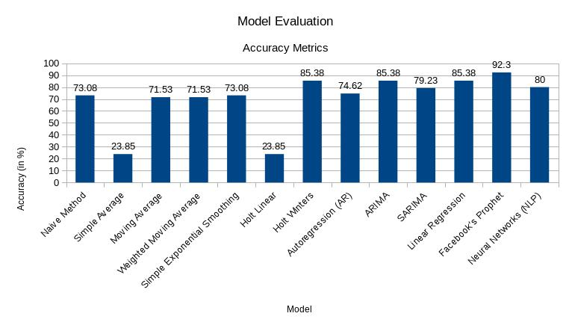
Accuracy

Slide 11
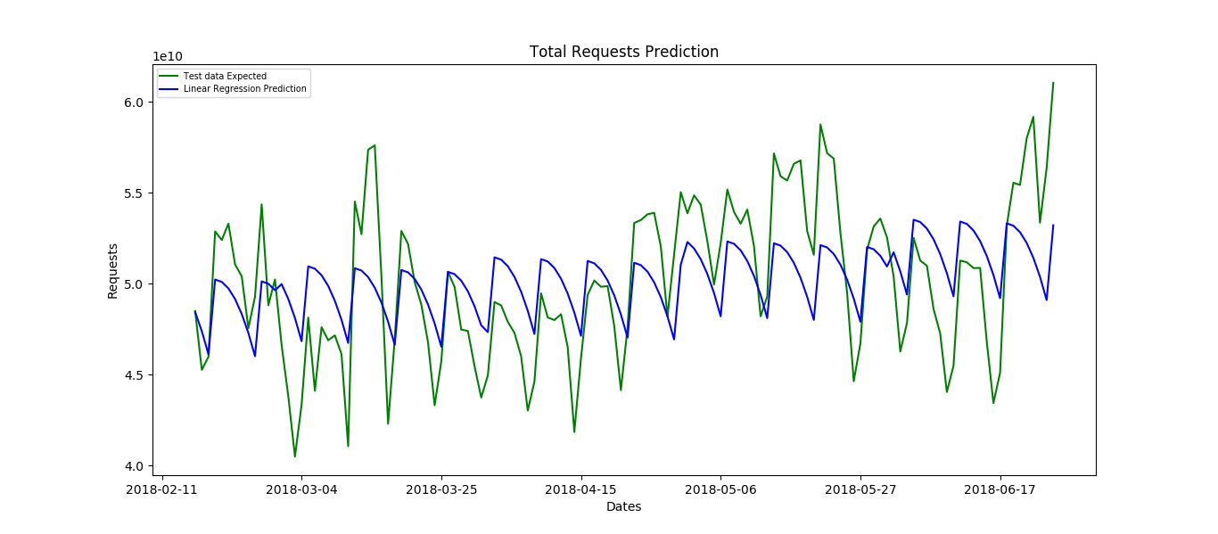
Models Finalized
Linear Regression (Accuracy=85.38 %)
Fit Time: 0.001s Predict Time: 0.0003s

Slide 12
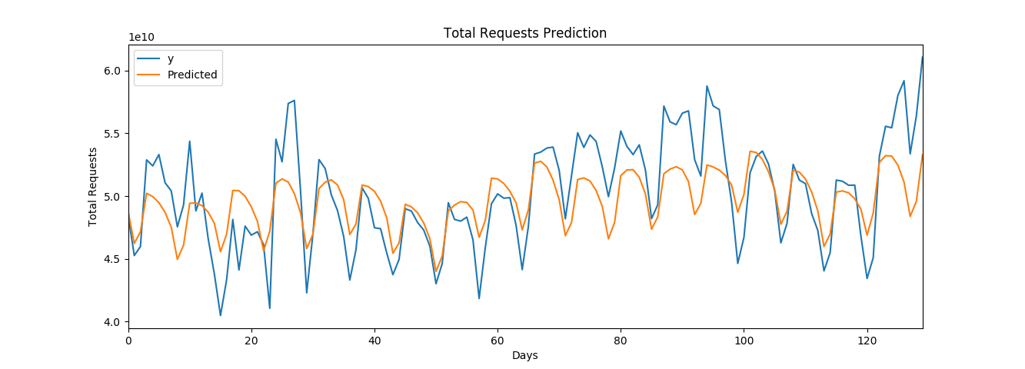
Prophet Model (Accuracy=92.3 %)
Fit Time: 0.0756s Predict Time:2.20s

Slide 13
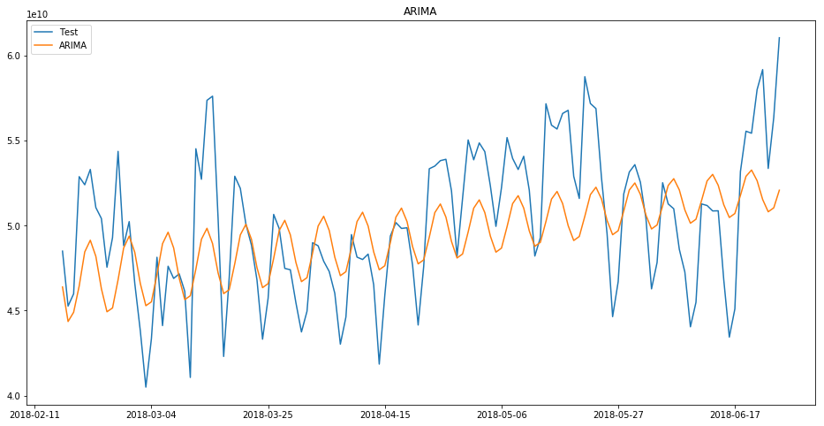
ARIMA (Accuracy=85.38 %)
Fit Time: 0.92s Predict Time: 0.0032s

Slide 14
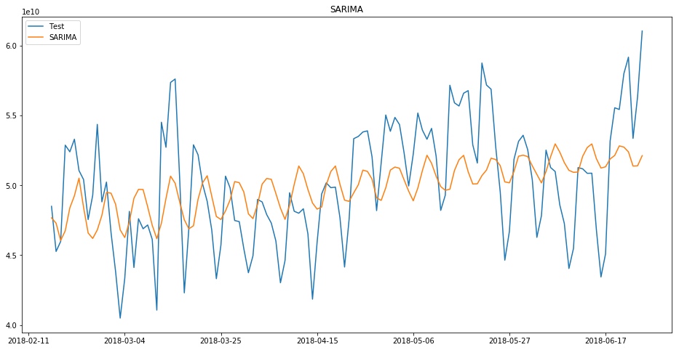
SARIMA (Accuracy=79.23 %)
Fit Time: 4.924s Predict Time: 0.0171s

Slide 15
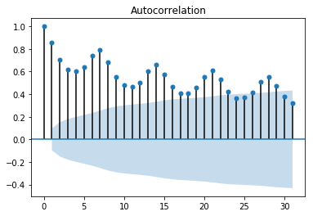
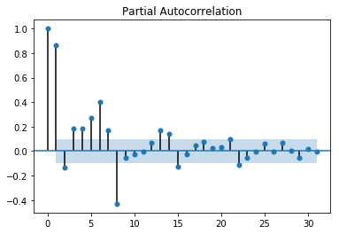
Parameter Tuning
Autocorrelation Function (ACF) Partial Autocorrelation Function (PACF)

Slide 16
Models Performing Order
Facebook’s Prophet Model > Linear Regression = ARIMA=Holt Winters

Slide 17
Forecasted Results
Date | Actual | Predicted
2/16/18 | 4.850004e+10 | 4.878478e+10
2/17/18 | 4.526684e+10 | 4.622818e+10
2/18/18 | 4.598501e+10 | 4.716618e+10

Slide 18
Thank You

